Slide 1
CSCI3120 Project: Simple Compiler
YU Wing Ching
1155175846
28/04/2025 19:30

Slide 2
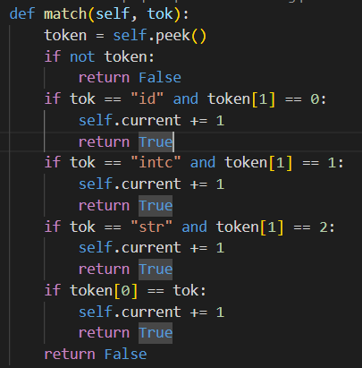
Context Free Grammar
bool Match(TOKEN tok)
LL(1)

Slide 3
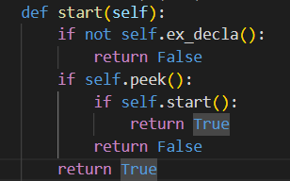
Context Free Grammar
bool START()
# START -> EX_DECLA | EX_DECLA START
Recursive Descent

Slide 4
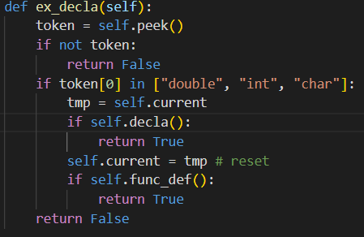
Context Free Grammar
bool EX_DECLA()
# EX_DECLA -> FUNC_DEF | DECLA
Recursive Descent

Slide 5
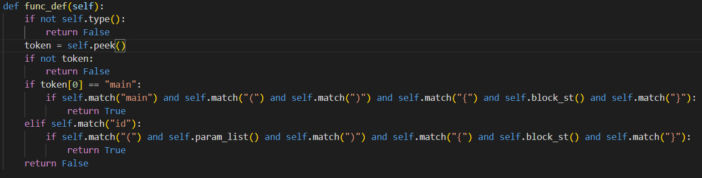
Context Free Grammar
bool FUNC_DEF()
# FUNC_DEF -> TYPE id(PARAM_LIST){BLOCK_ST} | TYPE main(){BLOCK_ST}
LL(1)

Slide 6
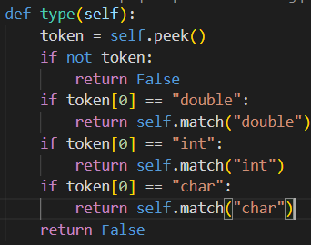
Context Free Grammar
bool TYPE()
# TYPE -> double | int | char
LL(1) / LR(0) reduce

Slide 7
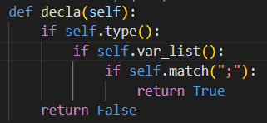
Context Free Grammar
bool DECLA()
# DECLA -> TYPE VAR_LIST;
Recursive Descent

Slide 8
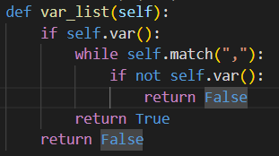
Context Free Grammar
bool VAR_LIST()
# VAR_LIST -> VAR VAR_LIST'
# VAR_LIST' -> , VAR VAR_LIST' | ɛ
Recursive Descent

Slide 9
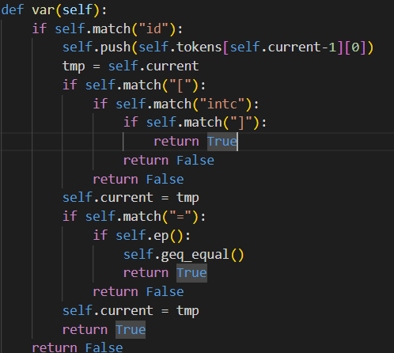
Context Free Grammar
bool VAR()
# VAR -> id [intc] | id{push id} INITIAL {GeQ=}
# INTITIAL -> = EP | ɛ
Recursive Descent

Slide 10
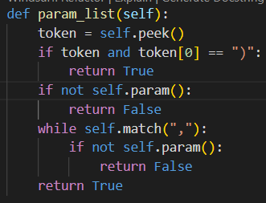
Context Free Grammar
bool PARAM_LIST()
# PARAM_LIST -> ɛ | PARAM | PARAM, PARAM_LIST
Recursive Descent

Slide 11
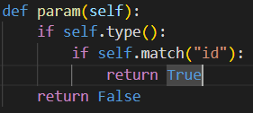
Context Free Grammar
bool PARAM()
# PARAM -> TYPE id
LR(0) shift

Slide 12
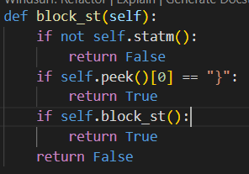
Context Free Grammar
bool BLOCK_ST()
# BLOCK_ST -> STATM | STATM BLOCK_ST
Recursive Descent

Slide 13
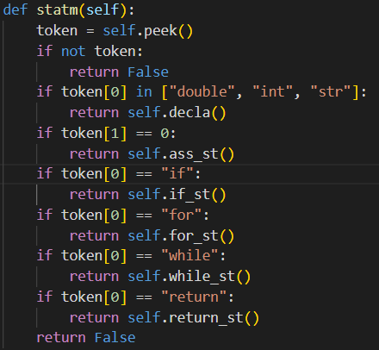
Context Free Grammar
bool STATM()
# STATM -> DECLA | ASS_ST | IF_ST | FOR_ST | WHILE_ST | RETURN_ST
LR(0) shift

Slide 14
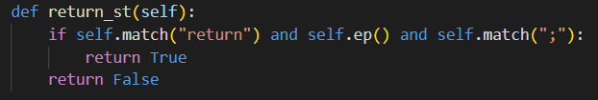
Context Free Grammar
bool RETURN_ST()
# RETURN_ST -> return EP;
recursive descent

Slide 15
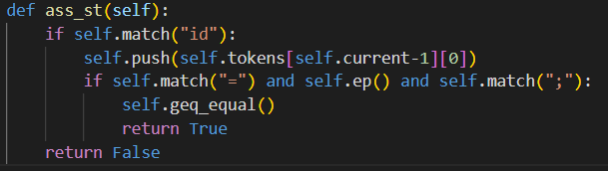
Context Free Grammar
bool ASS_ST()
# ASS_ST -> id{push id} = EP{GeQ=};
Recursive descent

Slide 16
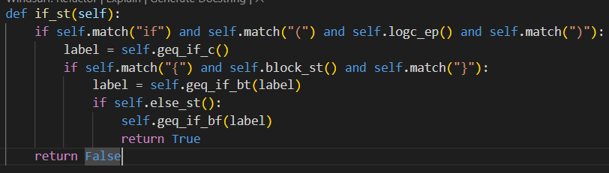
Context Free Grammar
bool IF_ST()
# IF_ST -> if (LOGC_EP){GeQifc}{BLOCK_ST} {GeQifbt}ELSE_ST {GeQifbf}
recursive descent

Slide 17
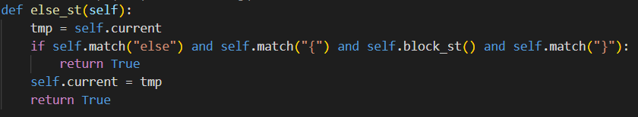
Context Free Grammar
bool ELSE_ST()
# ELSE_ST -> ɛ | else {BLOCK_ST}
recursive descent

Slide 18
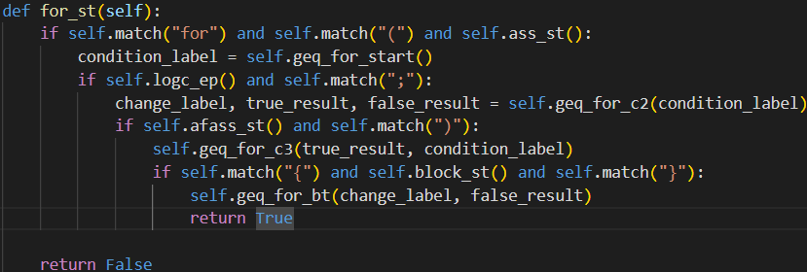
Context Free Grammar
bool FOR_ST()
# FOR_ST -> for( ASS_ST{GeQforstart} LOGC_EP;{GeQforc2} AFASS_ST){GeQforc3}{BLOCK_ST} {GeQforbt}
recursive descent

Slide 19
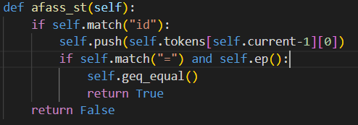
Context Free Grammar
bool AFASS_ST()
# AFASS_ST -> id{push id} = EP {GeQ=}
recursive descent

Slide 20
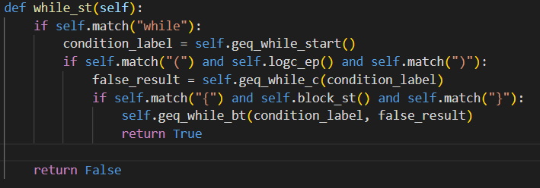
Context Free Grammar
bool WHILE_ST()
# WHILE_ST -> while{GeQwhilestart}(LOGC_EP){GeQwhilec}{BLOCK_ST} {GeQwhilebt}
recursive descent

Slide 21
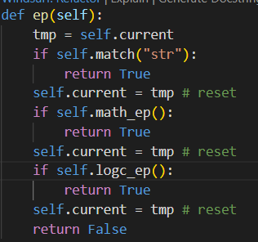
Context Free Grammar
bool EP()
# EP -> LOGC_EP | MATH_EP | str
recursive descent

Slide 22
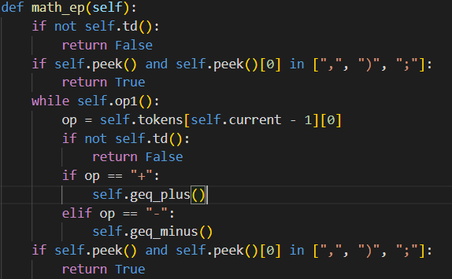
Context Free Grammar
bool MATH_EP()
# MATH_EP -> TD | TD op1 MATH_EP {GeQ+ or GeQ-}
recursive descent

Slide 23
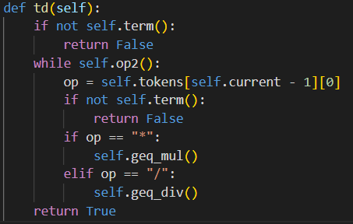
Context Free Grammar
bool TD()
# TD ->TERM | TERM op2 TD{GeQ* or GeQ/}
recursive descent

Slide 24
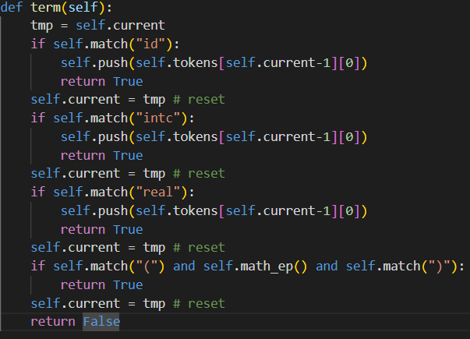
Context Free Grammar
bool TERM()
# TERM -> id{push id} | intc{push id} | real{push id} | ( MATH_EP )
recursive descent

Slide 25
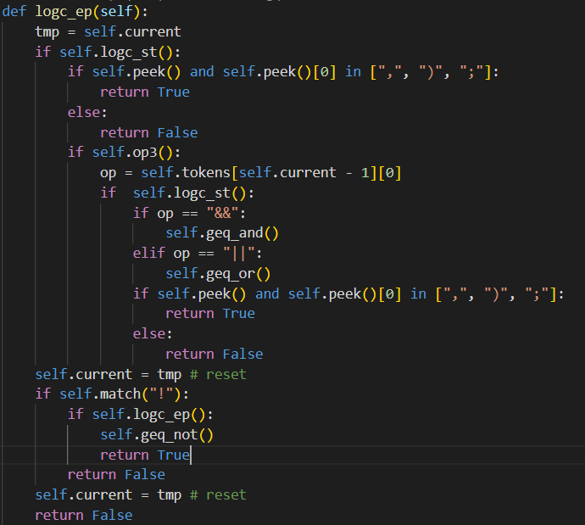
Context Free Grammar
bool LOGC_EP()
# LOGC_EP -> LOGC_ST | LOGC_ST op3 LOGC_ST{GeQ&& or GeQ||} | ! LOGC_EP {GeQ!}
recursive descent

Slide 26
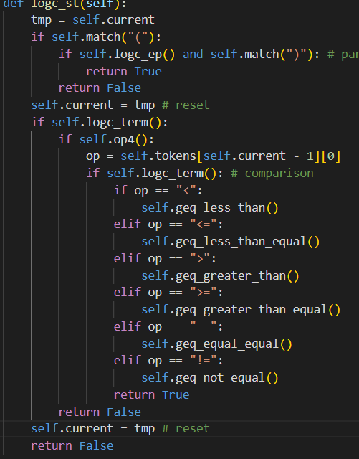
Context Free Grammar
bool LOGC_ST()
# LOGC_ST -> (LOGC_EP) | LOGC_TERM op4 LOGC_TERM {GeQ< or GeQ <= or GeQ >= or GeQ > or GeQ== or GeQ!=}
recursive descent

Slide 27
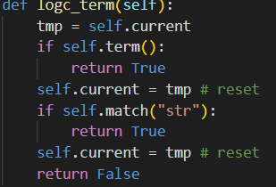
Context Free Grammar
bool LOGC_TERM()
# LOGC_TERM -> TERM | str
recursive descent

Slide 28
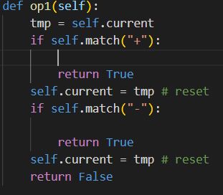
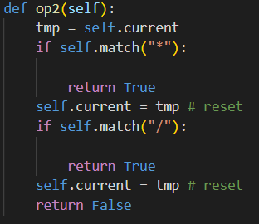
Context Free Grammar
bool OP1()
# op1 = { + | - }
recursive descent
bool OP2()
# op2 = { * | / }
recursive descent

Slide 29
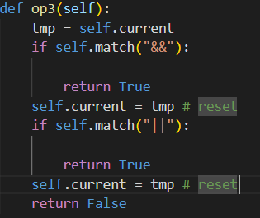
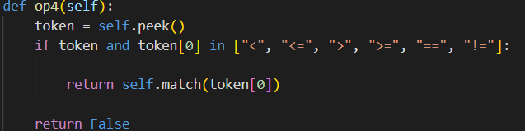
Context Free Grammar
bool OP3()
# op3 = { && | || }
recursive descent
bool OP4()
op4 = { < | <= | > | >= | == | != }
recursive descent

Slide 30
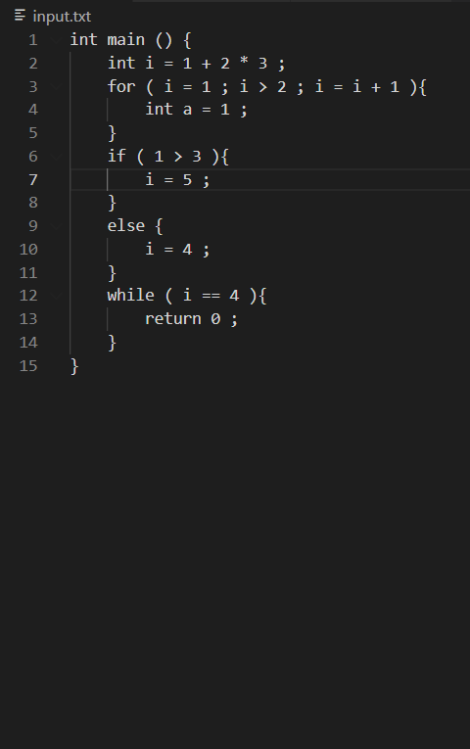
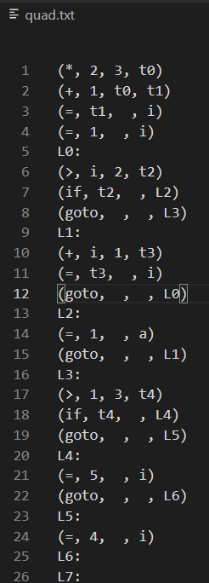

Accept Case

Slide 31

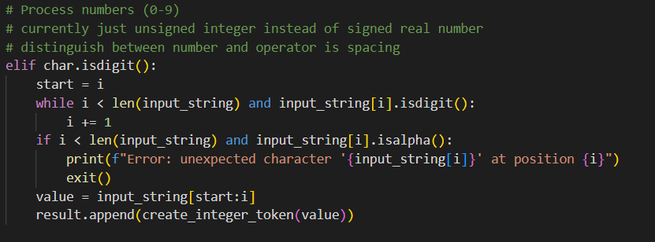
Reject Case
Lexical analysis, regex checking

Slide 32
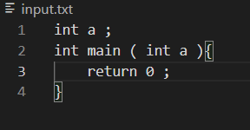

Reject Case
CFG

Slide 33
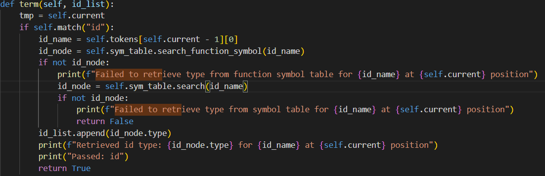
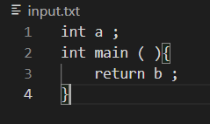
Reject Case
Symbol table

Slide 34
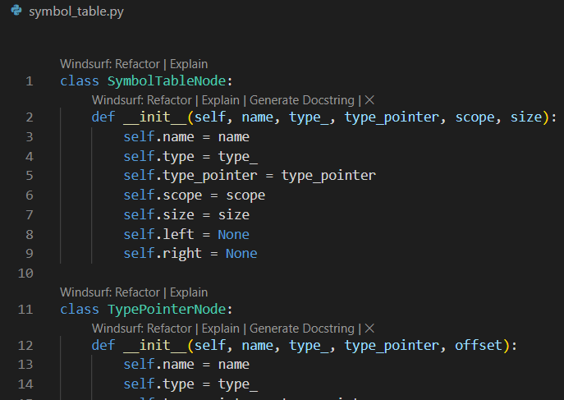
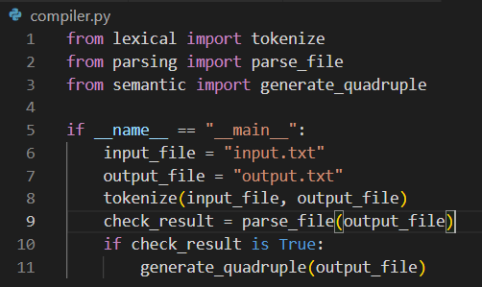
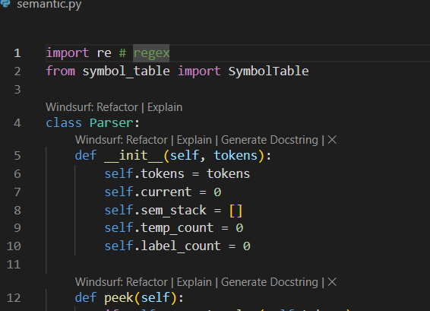
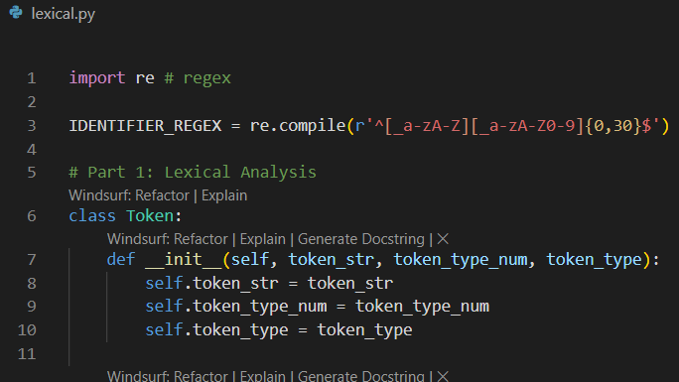
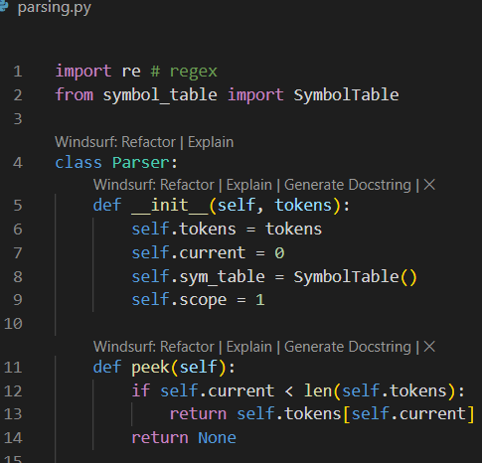
Modularization

